Slide 1

Improving Energy Forecasting in Puerto Rico’s Power Grid

Slide 2


Introduction: About Me
Preston Ewell
Bachelors of Science – Data Analytics
10 years of sales experience
Pivoted to Data Analysis in 2022
Critical thinker, naturally curious, and data-driven
Passionate about ensuring a sustainable future

Slide 3
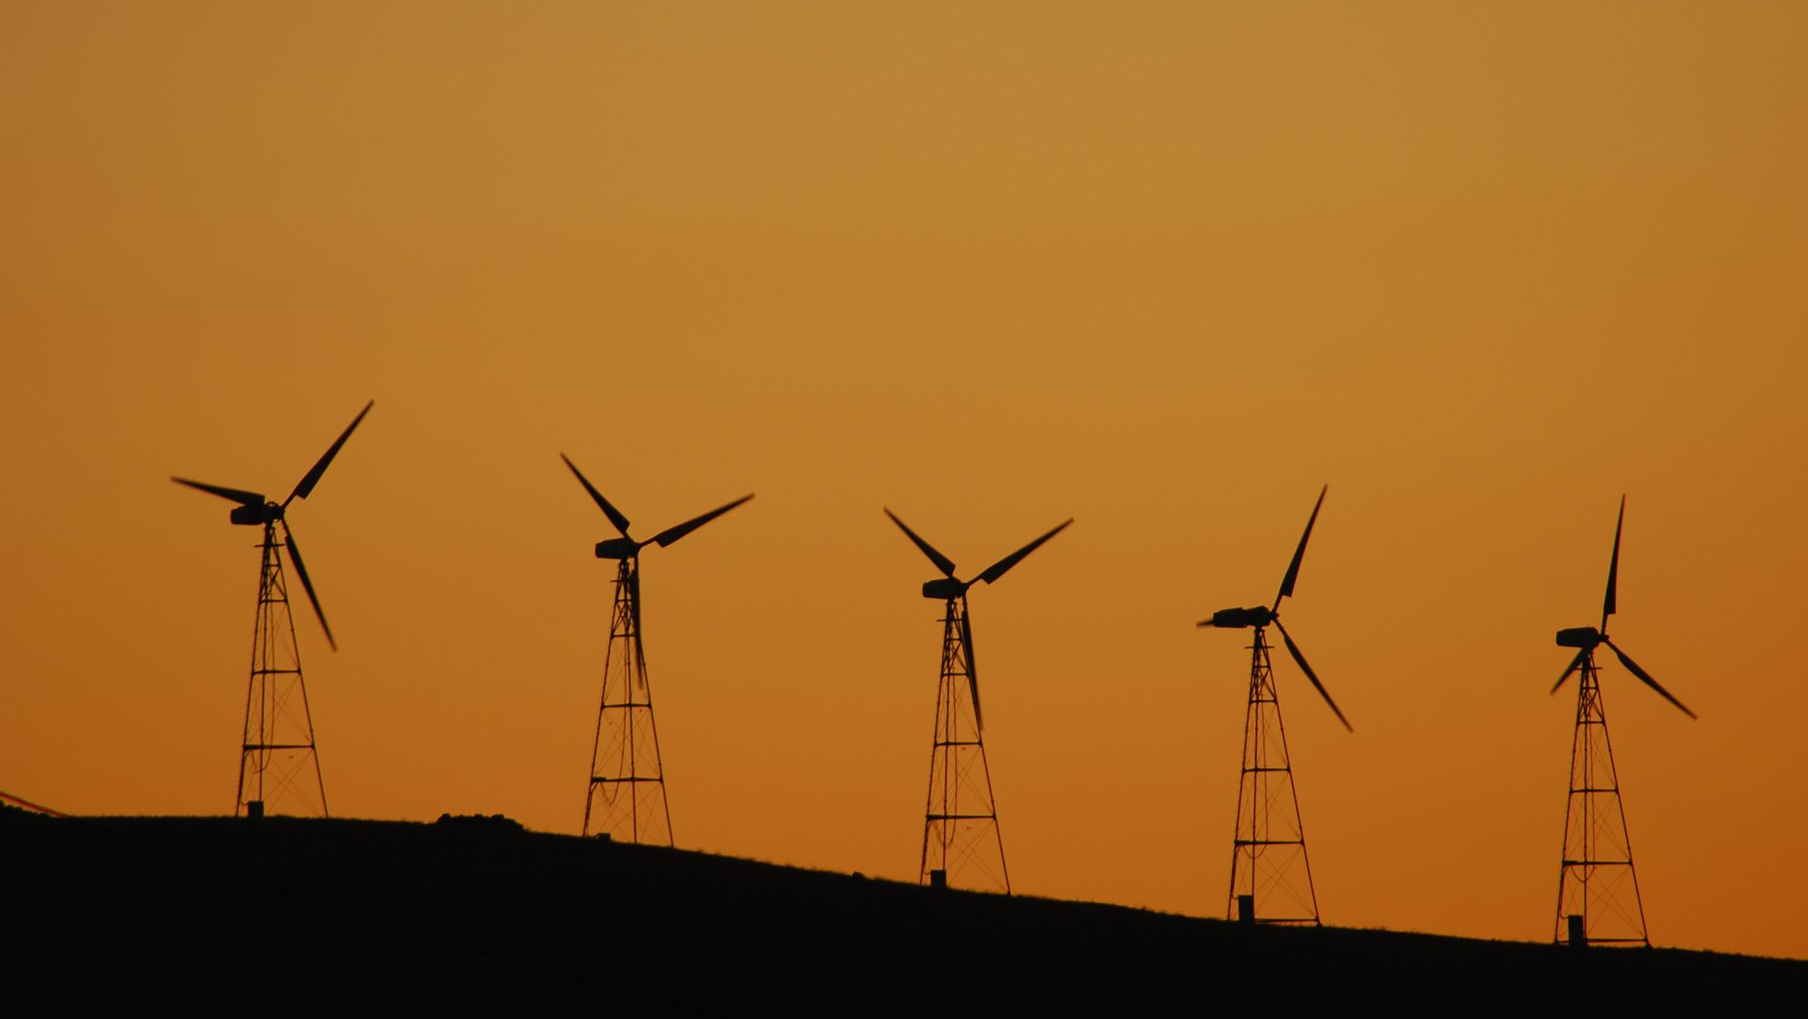
Problem Statement:
Puerto Rico's PR100 project is an ambitious initiative aimed at transforming the country’s energy system to 100% renewable energy by 2050, ensuring a sustainable and reliable power grid.
One of the challenges they face is in forecasting energy demand and capacity, especially during stress conditions, leading to mismatches that could cause energy shortages and waste.
Hypothesis:
Predictive analytics can improve the accuracy of forecasting these energy mismatches by utilizing historical data and grid performance metrics, thereby enabling better preparation and response.

Slide 4
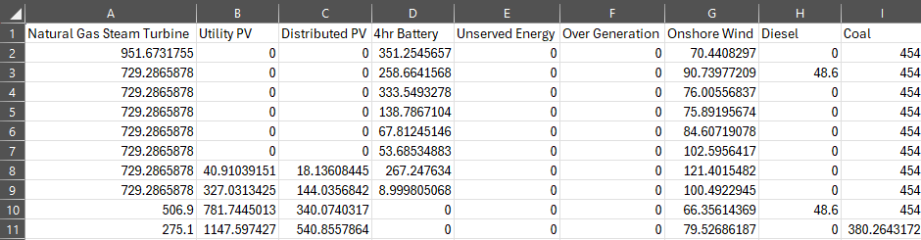
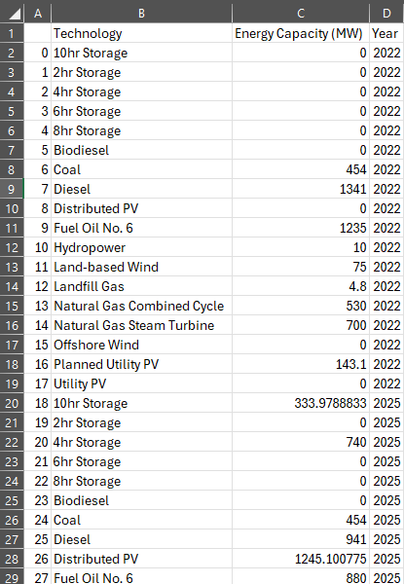
Summary of the Data Analysis Process
I gathered publicly available data from the U.S. Department of Energy, which includes predicted hourly energy generation and capacity for Puerto Rico, as part of the PR100 project.
The dataset focuses on energy generation and capacity for various technologies and scenarios, specifically targeting the year 2025.

Slide 5
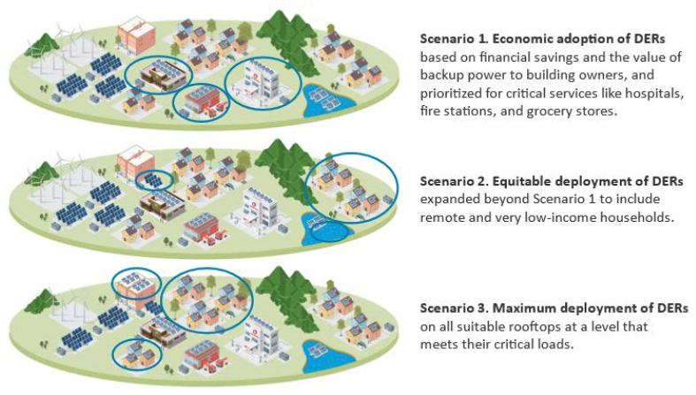
Scenario Descriptions
Three scenarios were created for PR100:
Economic Adoption - Promotes distributed energy resource (DER) adoption based on financial benefits for homeowners and businesses, with a focus on critical services.
Equitable Adoption - Builds on Scenario 1 by including DER adoption for remote and low-income households.
Maximum Adoption - Maximizes DER deployment on all suitable rooftops to meet critical energy needs across Puerto Rico.

Slide 6
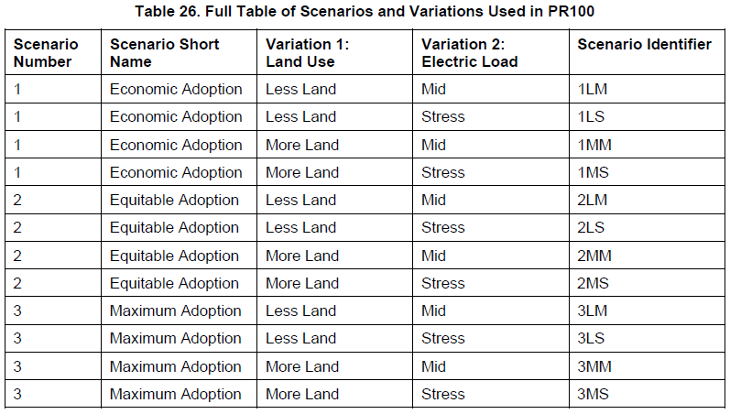
Scenario Descriptions cont.
Scenario and Variation Combinations
Combining Scenarios 1 through 3 with two load variations and two land use variations results in 12 total scenario combinations.
The scenarios primarily focus on different levels of distributed PV and storage. Additionally, variations include the use of agricultural land for utility-scale solar and wind, and two options for load trajectories.

Slide 7
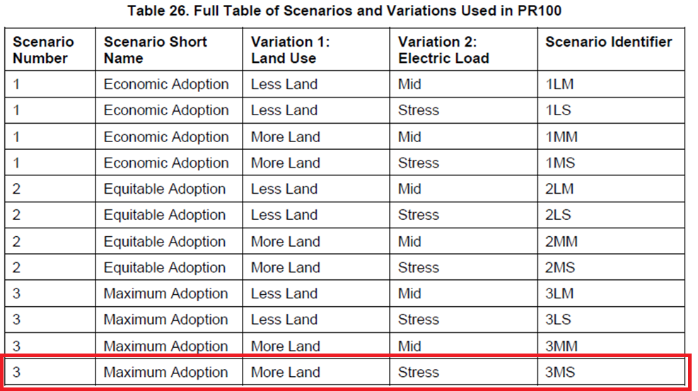
Scenario Descriptions cont.
Scenario and Variation Combinations
Combining Scenarios 1 through 3 with two load variations and two land use variations results in 12 total scenario combinations.
The scenarios primarily focus on different levels of distributed PV and storage. Additionally, variations include the use of agricultural land for utility-scale solar and wind, and two options for load trajectories.

Slide 8
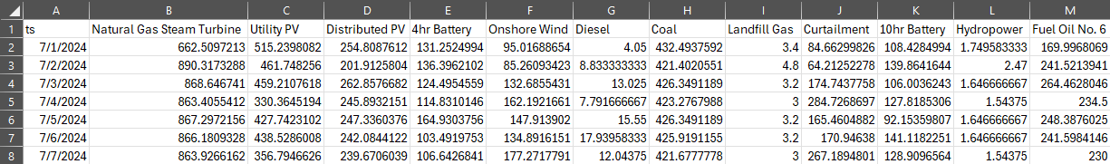
Data Preparation
Data was cleaned and processed.
Unnecessary columns were removed.
The data was resampled to daily frequency for easier analysis.
Combined the two datasets into one.
Calculated mismatch between energy generation and capacity.

Slide 9
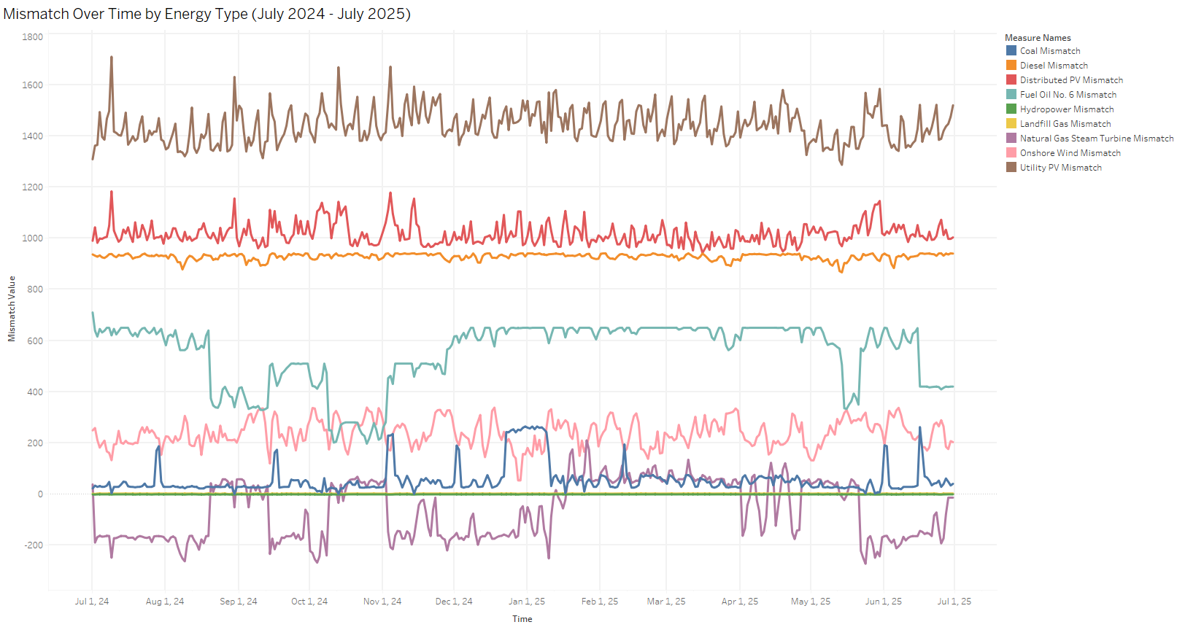
Analysis Techniques
Time series plot to visualize the energy mismatches:

Slide 10
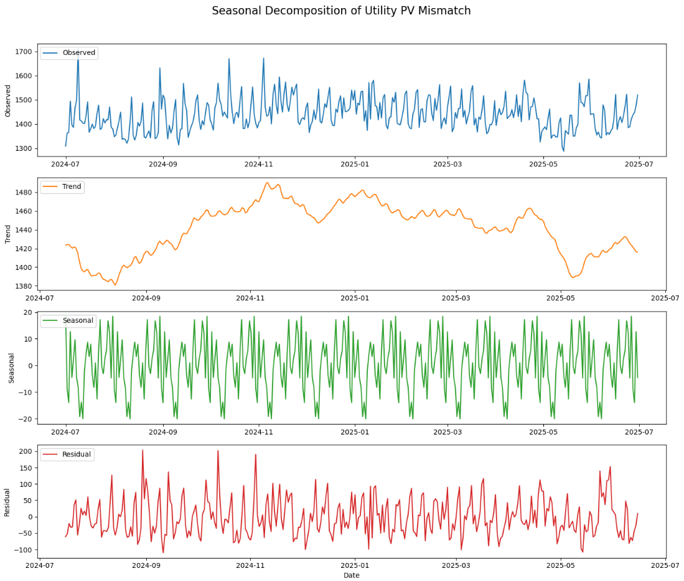
Analysis Techniques cont.
Seasonal decomposition to understand trends.

Slide 11
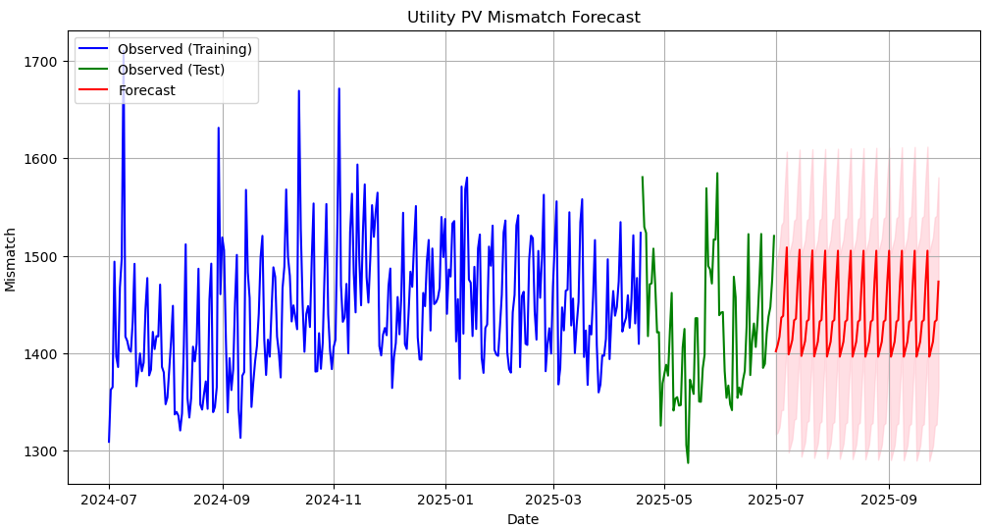
Analysis Techniques cont.
ARIMA modeling to forecast future mismatches.

Slide 12
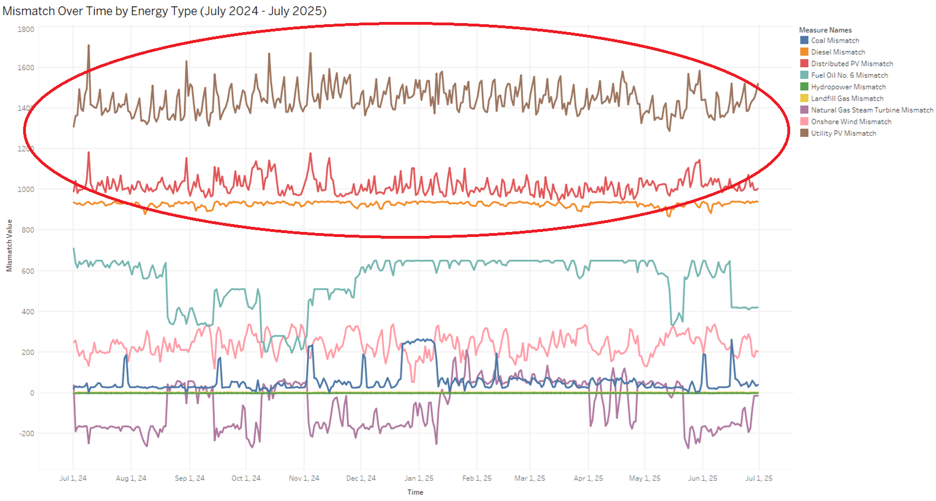
Key Findings
Significant mismatches were observed in renewable energy sources, particularly in Utility PV, Distributed PV, and Diesel technologies.

Slide 13
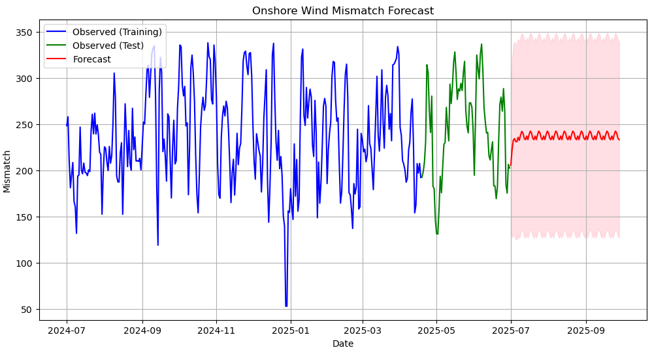
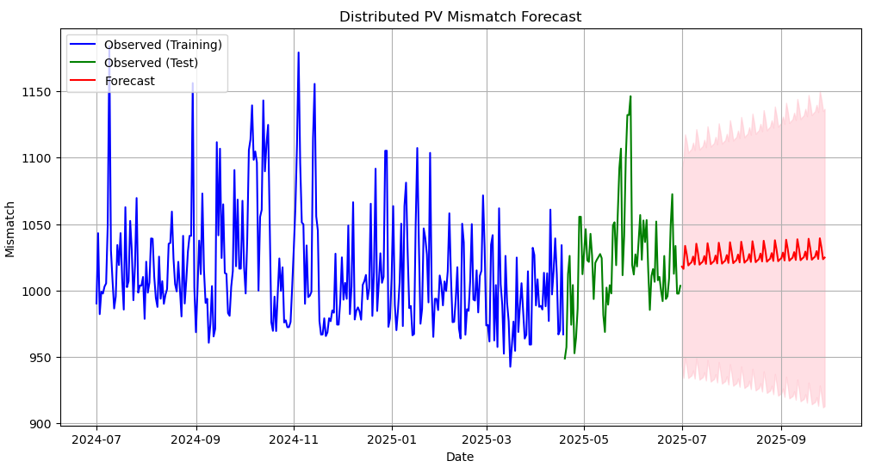
Key Findings cont.
The ARIMA model successfully forecasted future mismatches, providing insights into potential supply issues that could arise under stress conditions.

Slide 14
Limitations of Techniques and Tools
Pandas Library:
While efficient for data management, Pandas can be resource-intensive when dealing with very large datasets.
ARIMA Model:
Although effective for forecasting, the ARIMA model requires careful tuning and is computationally demanding. Additionally, our analysis was limited by the scope of available historical data, which only covered a predictive model for one year.

Slide 15

Proposed Actions
Infrastructure Enhancements:
Upgrade the energy distribution infrastructure to ensure better utilization of generated energy and reduce mismatches.
Integration of Battery Storage:
Implement battery storage systems to smooth out the forecasted mismatches and ensure a more consistent energy supply during peak demand periods.

Slide 16

Expected Benefits
Improved Reliability:
By addressing the identified mismatches, energy shortages can be reduced during peak stress periods, ensuring a more reliable energy supply.
Cost Savings:
Proactive infrastructure upgrades and the integration of battery storage could lead to a 10-20% reduction in operational costs associated with emergency energy distribution.

Slide 17
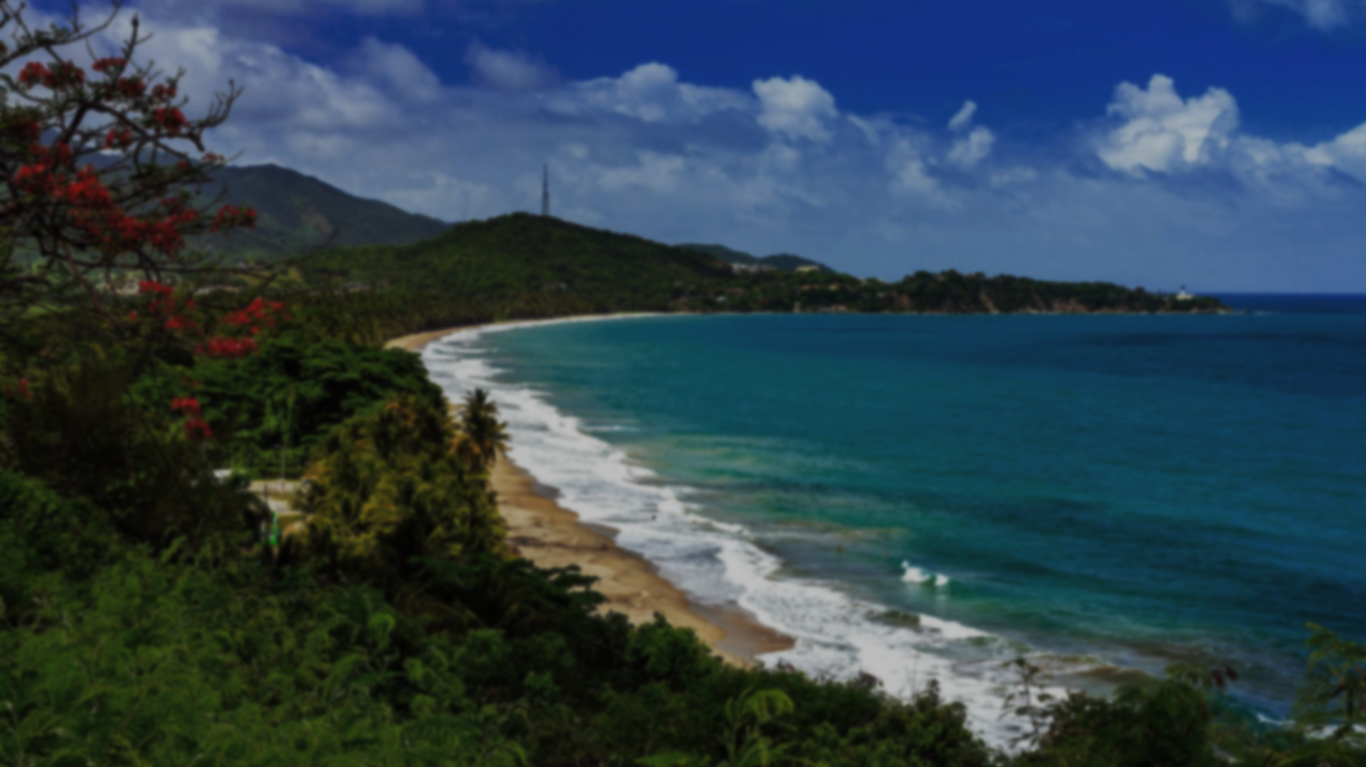
Conclusion
Predictive analytics holds significant potential in enhancing the reliability and efficiency of Puerto Rico’s energy grid. By implementing the proposed actions, we can better prepare for and mitigate potential energy shortages, contributing to a more sustainable energy future for the island.

Slide 18
Sources
National Renewable Energy Laboratory (NREL). (2024). Sienna Model. Retrieved from https://www.nrel.gov/analysis/sienna.html
National Renewable Energy Laboratory (NREL). (n.d.). Engage Tool. Retrieved from https://engage.nrel.gov/en/login/?next=/en/
National Renewable Energy Laboratory. (n.d.). PR100: Power sector modeling for Puerto Rico's grid modernization. Retrieved August 20, 2024, from https://pr100.gov/

